Slide 1
Sheveluch Volcano Event
10-17 April 2023
A mini-case on Ash and SO2 analysis using GOES and JPSS imagery and products in the morning of 12 April 2023
Nate Eckstein
Anchorage VAAC

Slide 2
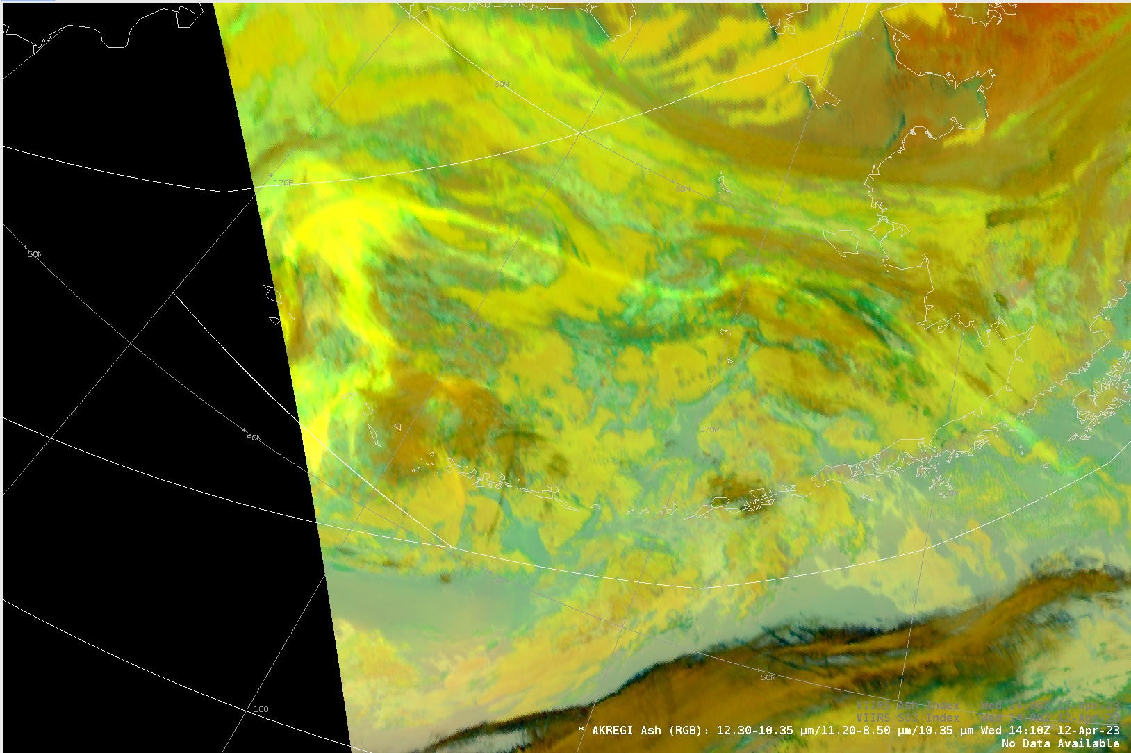
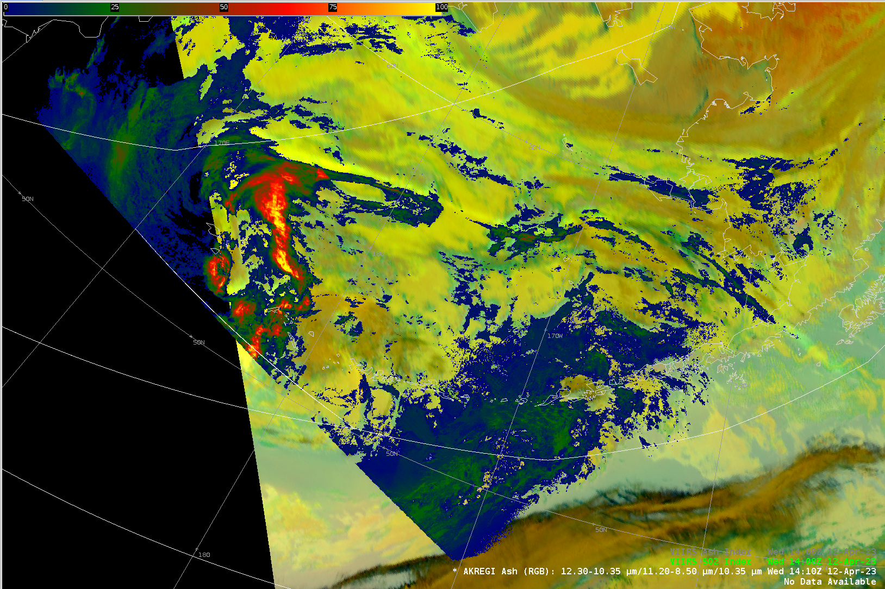
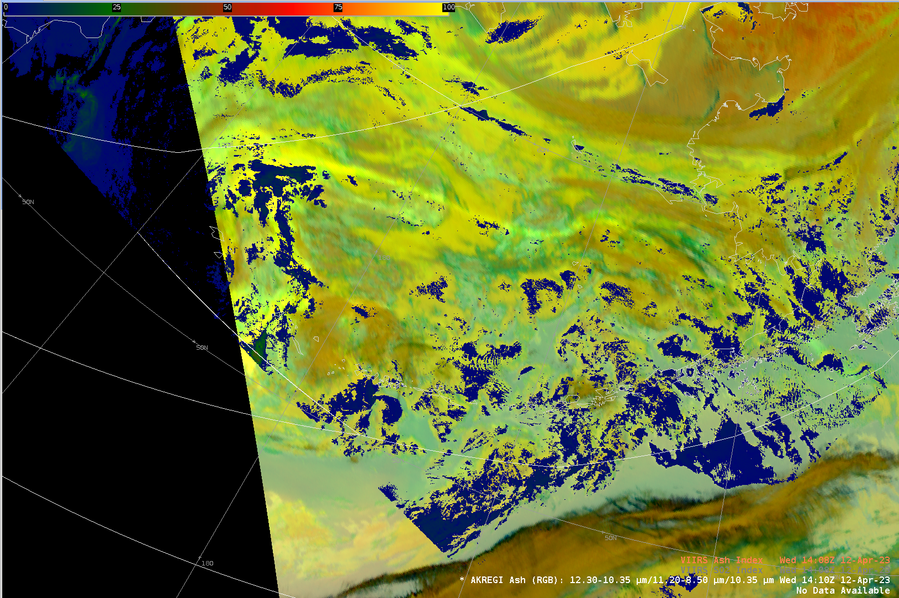
1410Z 12 April 2023
GOES-18 Ash RGB
GOES-18 Ash RGB and
VIIRS SO₂ Index
GOES-18 Ash RGB and
VIIRS Ash Index
Notes:
At this point in operations, we had a midnight shift take over part of the responsibility for the Ash cloud in the Anchorage VAAC AOR. This was based upon agreements with Tokyo VAAC that have been pre-arranged by scenario. Our midshift issued the first VAA from Anchorage at 1200Z 12 April 2023. The next advisory was due by 18Z.
Several VIIRS passes occurred over the Bering at 1140, 1230, 1320 and 1410Z. Early passes captured the eastern most areas of the SO2 cloud over the Alaska Peninsula, and the passes captured progressively western areas until the main ash cloud was captured at 1410Z.
Using the GOES Ash RGB with both VIIRS SO2 and Ash Index products proved useful in the analysis and provided confidence in the RGB analysis of an SO2 filament extending eastward over the Bering. This area was removed from the warning area before 18Z. See next slide.
NOTES: There is an hour latency between the VIIRS pass time and the arrival of the products, so the 1140Z VIIRS pass was not available for the 12Z product updates. It would have been latent even for an analysis which took place well before 1140Z. Worth pointing out when these products arrive in operations.

Slide 3
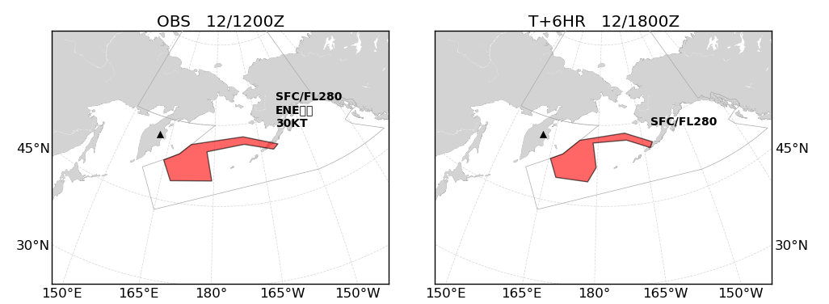
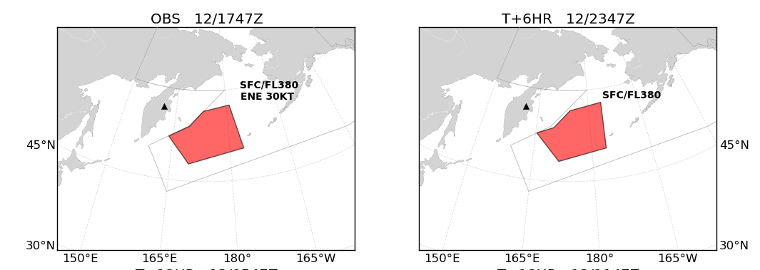
1200Z 12 April 2023
Advisory update at 1747Z adjusted the area, particularly the eastward reaching filament using GOES and JPSS imagery and products in the analyses.
The eastward reaching filament was determined to be entirely or primarily SO2. This was removed in the 1747Z update.
The 12Z forecast was starting to impact flights to SW Alaska and the update before 18Z allowed us to clear that space and concentrate the warning area over the west-central Bering Sea.
1747Z 12 April 2023
Notes:
The eastward extending filament was captured in the analysis and made part of the warning area upon handover from Tokyo VAAC. Upon further analysis with several AM passes covering the Bering Sea after 12Z, it was able to be determined that this filament was largely or all SO2 cloud and that it could be removed from the warning area. This is shown in the bottom OBS and T+6 HR update issued at 1747Z.

